Slide 1
Geometry, Mensuration & Trigonometry
Triangles
Angles and Sides
• The sum of any two sides of a triangle is greater than the third side.
• The line joining the mid-point of a side of a triangle to the opposite vertex is called the median. The median of a triangle divides it into two triangles of the same area.
• The point of intersection of the 3 medians of a triangle is called its centroid. The centroid divides each of the medians in the ratio 2 : 1.
• The perimeter of a triangle of sides of length a, b and c is (a + b + c).
Area:
Area of a triangle = Base x Height / 2.
Area of a triangle is √s(s – a)(s – b)(s – c) where s = semi perimeter = (a + b + c) / 2.
The area of the triangle formed by joining the mid-points of the sides of a given triangle is one-fourth of the area of the given triangle.

Slide 2
Properties:
Equilateral Triangle:
a) The angles of the triangle are equal to 60⁰ each.
b) All the sides of the triangle are equal.
c) Altitude of an equilateral triangle = √3a / 2
d) Area of an equilateral triangle = √3a²/4
Isosceles Triangle:
a) The two base angles of the triangle are equal.
b) Two sides of the triangle are equal.
Scalene Triangle:
a) No two angles have the same value.
b) No two sides have the same length.
Acute-angled Triangle:
a) All angles of the triangle are lesser than 90⁰.
Right-angled Triangle:
a) One angle of the triangle is 90⁰ while the other 2 are lesser than 90⁰ each.
b) a² = b² + c²

Slide 3
Ci1rcles – Angles, Radii and Area
1. Area of a circle = πR², where R is the radius
2. Circumference of a circle = 2πR
3. Length of an arc = 2πRθ / 360, where θ is the central angle.
4. Area of a sector = ½ x (arc length x R) = πR²θ / 360
5. Area of semi-circle = πR² / 2
Cube
1. Volume = a³ cubic units.
2. Surface area = 6a² sq. units.
3. Diagonal = a x √3 units.
Cuboid
1. Volume = (l x b x h) cubic units.
2. Surface area = 2(lb + bh + lh) sq. units.
3. Diagonal = √ (l² + b² + h²⁾ units.

Slide 4
Cylinder
1. Volume = π (r²h) cubic units.
2. Curved surface area = (2 π rh) sq. units.
3. Total surface area = 2 π r(h + r) sq. units.
Sphere
1. Volume = (4 / 3) π r³ cubic units.
2. Surface area = (4 π r²) sq. units.
Hemi-Sphere
1. Volume = (2 / 3) π r³ cubic units.
2. Curved surface area = (2 π r²) sq. units.
3. Total surface area = (3 π r²) sq. units.
Cone
1. Slant height, l = √(h² + r²) units.
2. Volume = (π r²h / 3) cubic units.
3. Curved surface area = (π rl) sq. units.
4. Total surface area = πrl + π r² sq. units.

Slide 5
Quadrilaterals
Trapezium:
A quadrilateral having exactly one pair of parallel sides is called a trapezium.
Isosceles Trapezium:
A trapezium whose non-parallel sides are equal in length is called an isosceles trapezium.
Parallelogram:
A quadrilateral is said to be a parallelogram if both pairs of its opposite sides are parallel.
Rhombus:
A parallelogram having all sides equal is called a rhombus.
Rectangle:
A quadrilateral in which each angle is a right angle is called a rectangle.
Square:
A square is a quadrilateral in which all sides are equal and each angle measures 90⁰.

Slide 6
Angles and Sides:
The diagonals of a parallelogram bisect each other.
Perimeter of a rectangle = 2(Length + Breadth)
Perimeter of a square = 4 x length of a side
Each diagonal of a parallelogram divides it into triangles of the same area.
The diagonals of a rectangle are equal and bisect each other.
The diagonals of a square are equal and bisect each other at right angles.
The diagonal of a square of side a = a√2.
The diagonals of a rhombus are unequal and bisect each other at right angles.
The sum of angles of a quadrilateral is 360 °
Area:
1. Area of a rectangle = (Length x Breadth).
2. Area of a square = (side)² = ½ x (diagonal)².
3. Area of parallelogram = (Base x Height).
4. Area of a rhombus = ½ x (Product of diagonals).
5. Area of a trapezium = ½ x (sum of parallel sides) x distance between them.

Slide 7
1. How many tiles whose length and breadth are 12 cm and 5 cm respectively will be needed to fit in a rectangular region whose length and breadth are respectively 144 cm and 100 cm:
Number of tiles required =14400/60 =240
Therefore, 240 tiles are required
Solution:
Total area of the region =100×144 =14400 ${cm}^{2}$
Total area of the region =100×144 =14400 〖𝑐𝑚〗^2
Area of one tile =12×5 =60 ${cm}^{2}$
Area of one tile =12×5 =60 〖𝑐𝑚〗^2

Slide 8
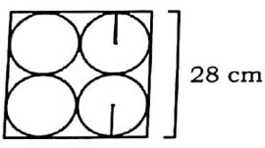
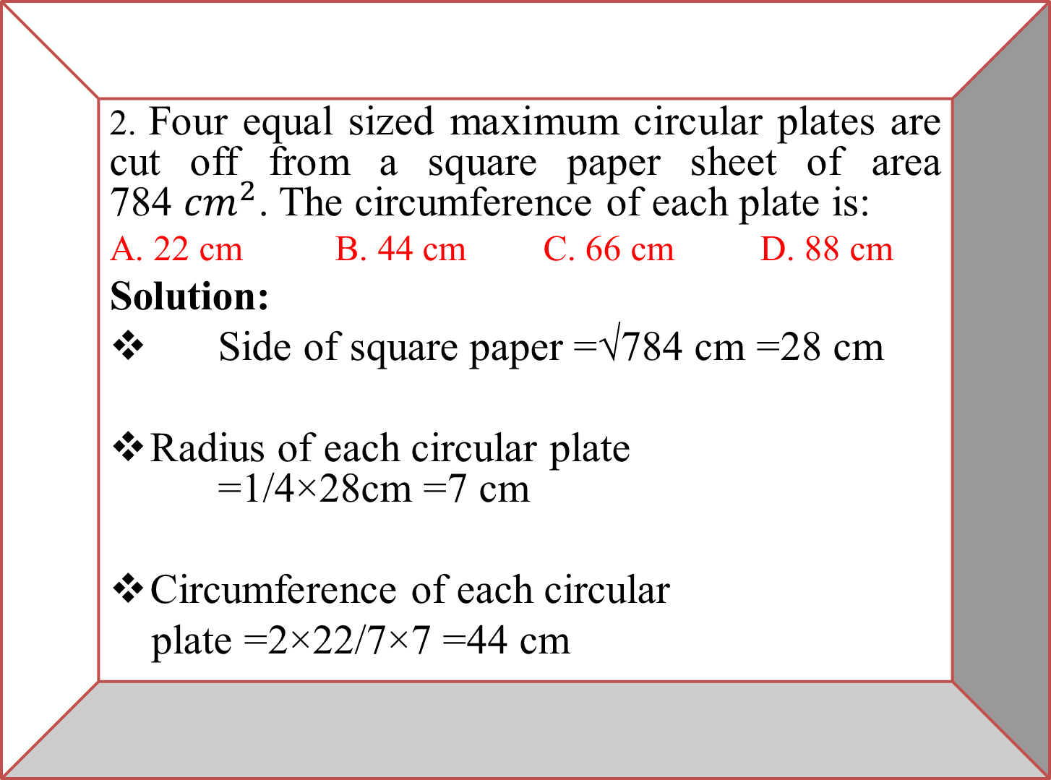
2. Four equal sized maximum circular plates are cut off from a square paper sheet of area 784 ${cm}^{2}$. The circumference of each plate is:
A. 22 cm B. 44 cm C. 66 cm D. 88 cm
Solution:
Side of square paper =√784 cm =28 cm
Radius of each circular plate =1/4×28cm =7 cm
Circumference of each circular
plate =2×22/7×7 =44 cm

Slide 9
3. In triangle PQR length of the side QR is less than twice the length of the side PQ by 2 cm. Length of the side PR exceeds the length of the side PQ by 10 cm. The perimeter is 40 cm. The length of the smallest side of the triangle PQR is :
A. 6 cm B. 8 cm C. 7 cm D. 10 cm
Solution:
QR = 2PQ – 2 and PR = PQ + 10
PQ + QR + PR = 40
PQ + 2PQ - 2 + PQ +10 = 40
4PQ = 32
PQ = 8 cm which is the smallest side of the triangle.

Slide 10
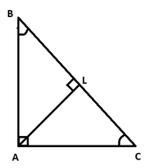
4. In an isosceles triangle ABC,∠ A = 90, AL is drawn perpendicular to BC. Find ∠ BAL.
Solution:
∠A + ∠B + ∠C = 180
∠B = ∠C = (180 – 90)/2= 45
∠BAL + ∠BLA + ∠B = 180
∠BAL = 180 – 90 – 45 = 45

Slide 11
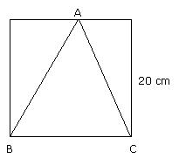
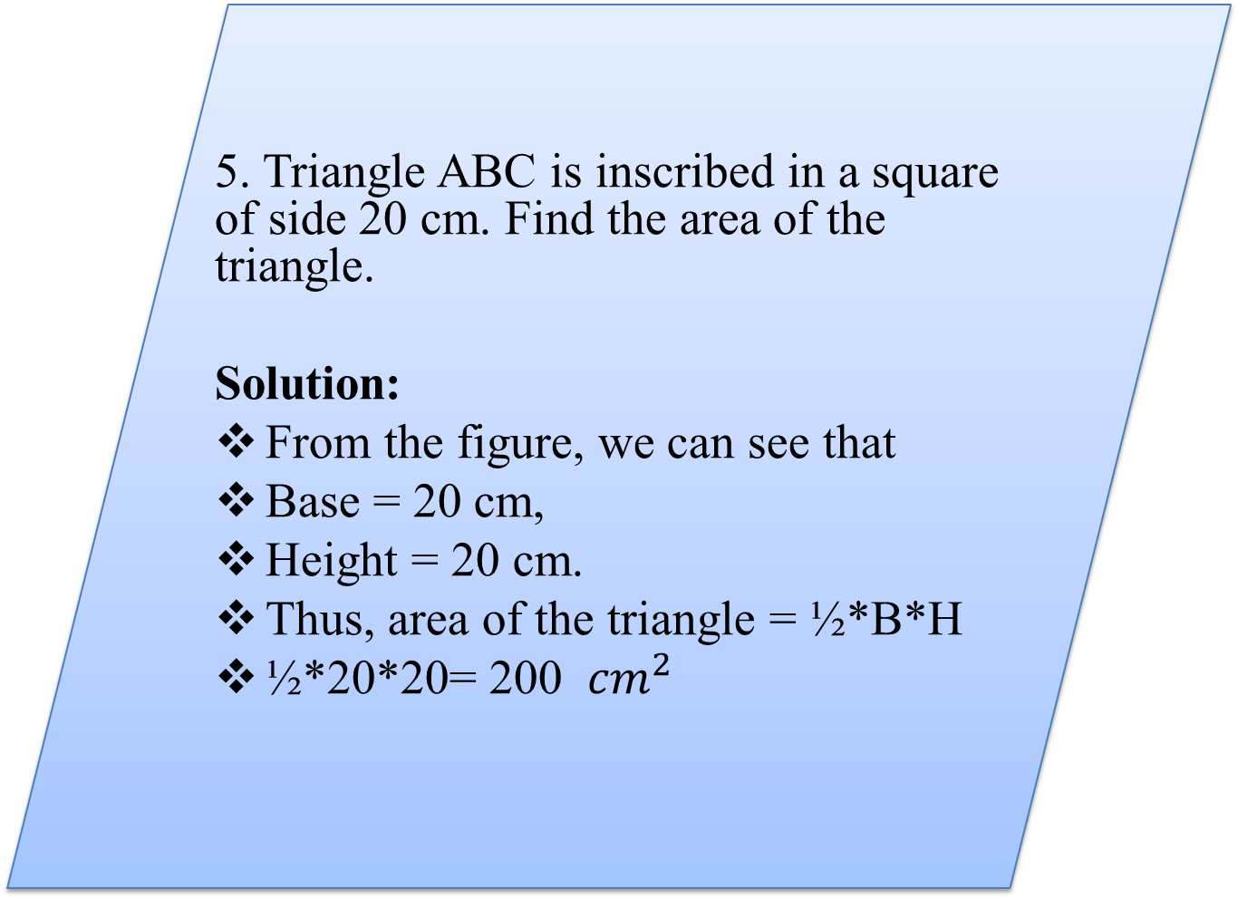
5. Triangle ABC is inscribed in a square of side 20 cm. Find the area of the triangle.
Solution:
From the figure, we can see that
Base = 20 cm,
Height = 20 cm.
Thus, area of the triangle = ½*B*H
½*20*20= 200 ${cm}^{2}$

Slide 12
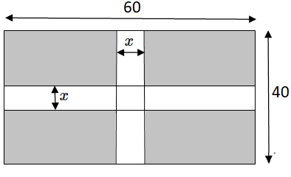
6. A rectangular park 60 m long and 40 m wide has two concrete crossroads running in the middle of the park and rest of the park has been used as a lawn. If the area of the lawn is 2109 sq. m, then what is the width of the road?
Solution:
Total area of park= 60*40= 2400sq.m
Lawn area = 2109 sq.m
That means there is a difference of 291 sq.m(this is the area of the two cross roads). Lets take 'x' as the width of the road.
ie, 60*x + 40*x - (x*x) = 291
100x - 2x =291
98x =291
x = 2.96
ie, x =3

Slide 13
7. What is the height of the triangle? If the area of the triangle is 20 times its base.
Solution:
1/2 x B x H = 20 x B
H=40

Slide 14
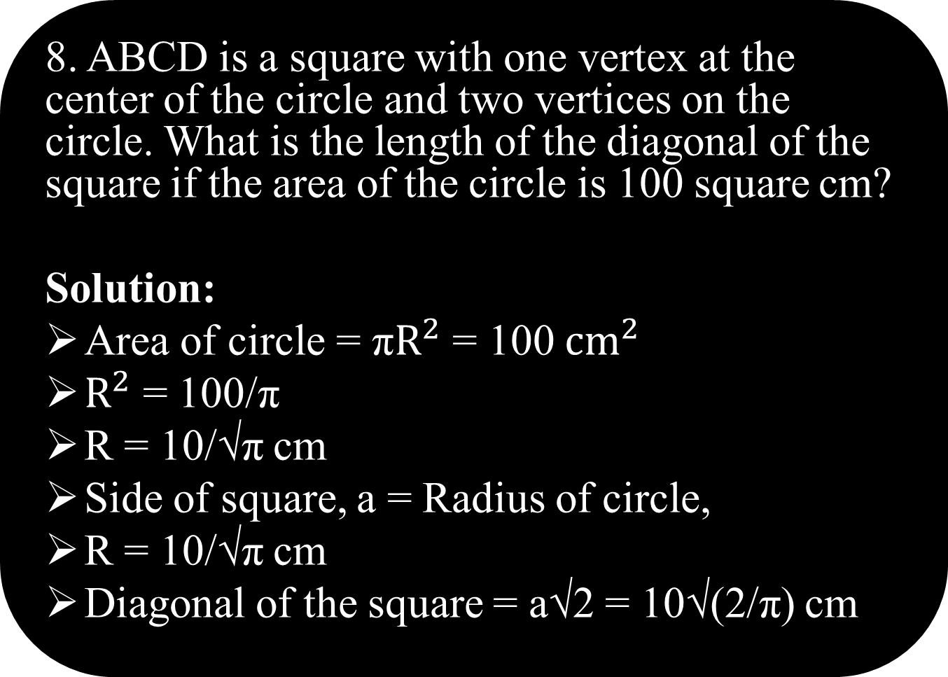
8. ABCD is a square with one vertex at the center of the circle and two vertices on the circle. What is the length of the diagonal of the square if the area of the circle is 100 square cm?
Solution:
Area of circle = π${\text{R}}^{2}$ = 100 ${\text{cm}}^{2}$
${\text{R}}^{2}$ = 100/π
R = 10/√π cm
Side of square, a = Radius of circle,
R = 10/√π cm
Diagonal of the square = a√2 = 10√(2/π) cm

Slide 15
9. A large cube is formed from the material obtained by melting three smaller cubes of 3, 4 and 5 cm side. What is the ratio of the total surface areas of the smaller cubes and the large cube?
Solution:
Volume of the larger cube = Total volume of the
smaller cubes = (3³ + 4³ + 5³) cm³ = 216 cm³
Side of the cube = (216)^{1/3} = 6 cm
Surface area of the larger cube = 6 x 6 x 6 = 6 x 36 cm²
Total surface area of the smaller cubes
= 6 x (3² + 4² + 5²) cm² = 6 x 50 cm²
Required ratio = 50 / 36 = 25:18.

Slide 16
10. 50 Men took a dip in a water tank 40 m long and 20 m broad on a religious day. If the average displacement of water by a man is 4m³, then calculate the rise in the water level.
Solution:
Total volume of water displaced = 50 x 4m³ = 200 m³
Change in volume of the tank occupied = length x breadth x change in height.
Change in height = 200 m³ / (40 m x 20 m ) = 0.25 m = 25 cm.

Slide 17
Solution:
From the question, we can say that r = 3 cm, h = 4 cm and l = 5 cm.
Thus, volume of the cone = π x 3 x 3 x 4 /3 = 12 π cm².
11. A right triangle with sides 3 cm, 4 cm and 5 cm is rotated along the side of 3 cm to form a cone. Find the volume of the cone so formed.

Slide 18
12. Calvin is making a model Earth in his science class. The radius of the inner core of the model Earth is 4 cm and the radius of the entire model is 10 cm. How many times larger is the volume of the entire model than the volume of the inner core?
Solution:
Volume of core = (4 / 3) π x 4 x 4 x 4 cm³
Volume of earth = (4 / 3) π x 10 x 10 x 10 cm³
Volume of entire model = (1000 / 64) times the volume of the core =15.625 times the volume of the core.

Slide 19
13. A hollow iron pipe is 21 cm long and its external diameter is 8 cm. If the thickness of the pipe is 1 cm and iron weighs 8 g/cm³, what is the weight of the pipe?
Solution:
External radius R = 4 cm, Internal radius r = (4 – 1) cm = 3 cm
Volume of the pipe = Total solid volume – Volume of hollow part
= π(R² – r²)h
= 22 / 7 x (4x4 – 3x3) x 21 = 462 cm³.
Mass of the pipe = density x volume
= 8 x 462 = 3696 gm = 3.696 kg.

Slide 20
14. 66 cm³ of silver is drawn into a wire 1 mm in diameter. Find the length of the wire in meters.
Solution:
Radius of the wire r = 0.5 mm = 0.05 cm and let length = l.
Volume of the wire = 66 cm³ = π r² l = 22 / 7 x 0.05 x 0.05 x l
=>l = 66 x 7 / (22 x 0.05 x 0.05) = 8400 cm = 84 m.

Slide 21
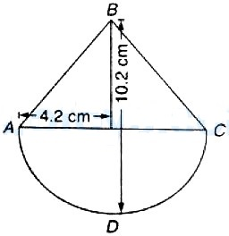
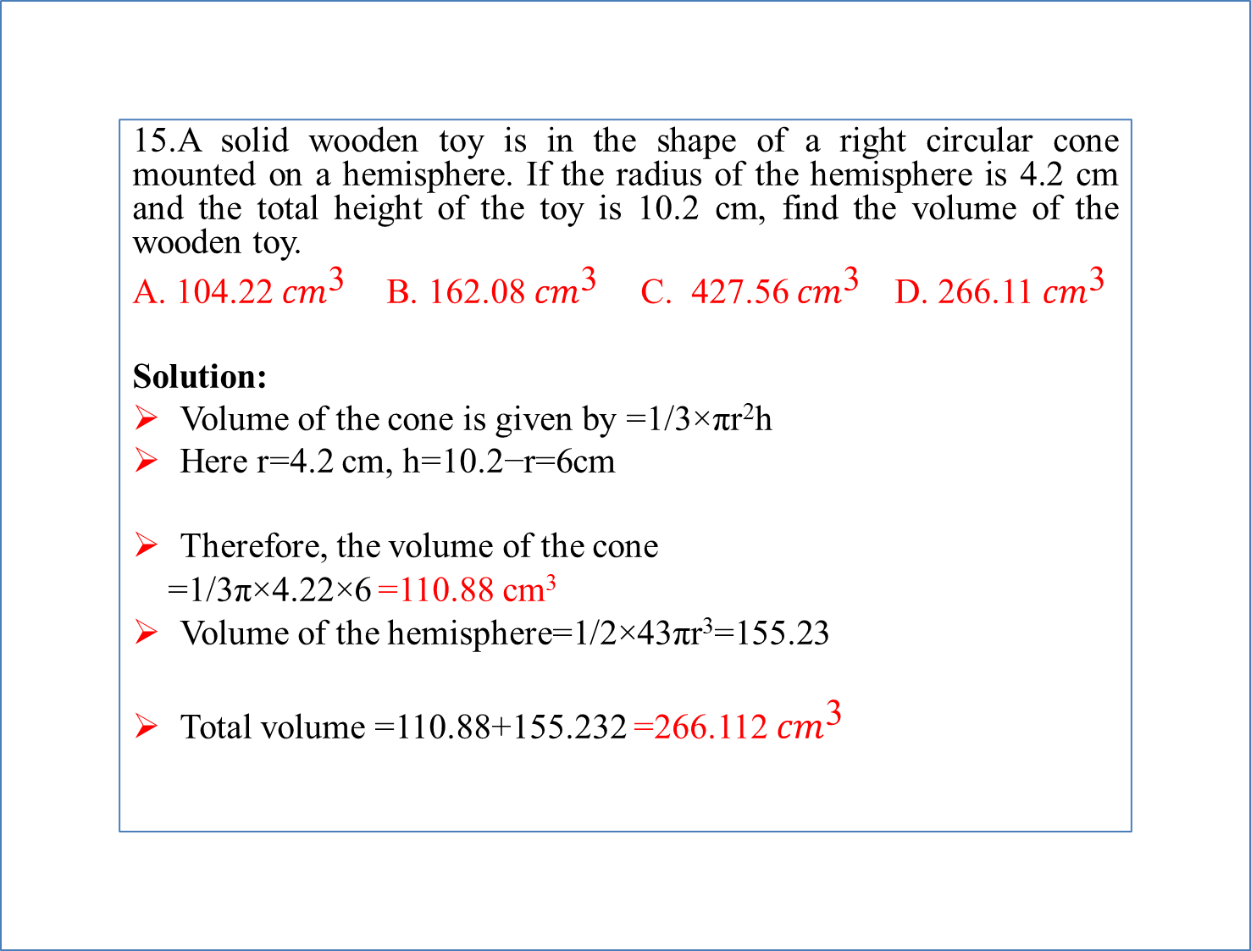
15.A solid wooden toy is in the shape of a right circular cone mounted on a hemisphere. If the radius of the hemisphere is 4.2 cm and the total height of the toy is 10.2 cm, find the volume of the wooden toy.
A. 104.22 ${cm}^{\text{3}}$ B. 162.08 ${cm}^{\text{3}}$ C. 427.56 ${cm}^{\text{3}}$ D. 266.11 ${cm}^{\text{3}}$
Solution:
Volume of the cone is given by =1/3×πr²h
Here r=4.2 cm, h=10.2−r=6cm
Therefore, the volume of the cone
=1/3π×4.22×6 =110.88 cm³
Volume of the hemisphere=1/2×43πr³=155.23
Total volume =110.88+155.232 =266.112 ${cm}^{\text{3}}$

Slide 22
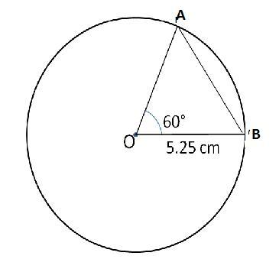
A chord AB of a circle of radius 5.25 cm makes an angle of 60∘ at the centre of the circle. Find the area of the major segment.
Solution:
The given circle is an equilateral triangle
Area of the minor sector =60/360 ×π×5.25² =14.4375 cm²
Area of the triangle =3/√4×5.25² =11.93 cm²
Area of the minor segment = Area of the minor sector - Area of the triangle =2.5 cm²
Area of the major segment
= Area of the circle - Area of the minor segment
= 86.54 cm²−2.5 cm² =84 cm²

Slide 23
17. If AD, BE, CF are medians of ∆ABC and O is the centroid of ∆ABC. If the area of ∆AOF is 36 cm^2 then the area of ∆OFB + area of ∆OEC =?
Solution:
Here, ‘O’ is the centroid of ∆ABC.
Then are of ∆AOF = area of ∆OFB = area of ∆OEC.
Area of ∆OFB + area of ∆OEC = 36 + 36 = 72 cm²

Slide 24

18. If 3 and 8 are the lengths of two sides of a triangular region, which of the following can be the length of the third side?
Solution:
In any triangle, the length of the third side must be less than the sum of the lengths of the other two sides and greater than the difference of the other two sides. 8-3 < t < 8+3 5 < t < 11.
Thus, only II is a possible length for the third side.

Slide 25

19. Two sides of a triangle have lengths 8 and 4. Find number of possible lengths with integer of the third side.
Solution:
L-S+1= no of triangles
L= sum of given two side-1=11
S= Difference of given two side +1=5
=11-5+1=7
7 Triangles possible

Slide 26

20.A cone and a hemisphere have equal bases and equal volumes. Find the ratio of their heights.
Solution:
Volume of the cone =πr²h/3
=Volume of a hemisphere
=2πr³/3=2πr³3
⇒ Height of a hemisphere = Radius of its base
By the above formula, we can see that h:r=2:1

Slide 27

21. The length, breadth and height of a room are in the ratio 3:2:1. If the breadth and height are halved while the length is doubled, then the total area of the four walls of the room will.
A. Remain the same B. Decrease by 30%
C. Decrease by 15% D. Decrease by 18.75%
Solution:
Let the original length, breadth and height of the room be 3x, 2x and x respectively.
Therefore, the new length, breadth and height are 6x, x and x/2 respectively.
Area of four walls = (2 × length × height) + (2 × breadth × height)
Original area of four walls =(2 × 3x × x)+(2×2x×x)
=6x²+4x²=10x²
New area of four walls =(2× 6x × x/2)+(2× x × x²)
=6x²+x²=7x²
Therefore, Area of wall decreases by =[10x²−7x²/10x²]×100 =30%

Slide 28
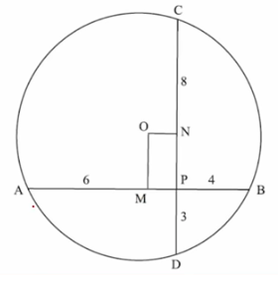

22. Two mutually perpendicular chords AB and CD meet at a point P inside the circle such that AP = 6 cms, PB = 4 units and DP = 3 units. What is the area of the circle?
A.125π/4 sq cms B.100π/7 sq cms C. 125π/8 sq cms D. 2π/3 sq cms
Solution:
As AB and CD are two chords that intersect at O, AP * PB = CP * PD 6 * 4 = CP * 3 CP = 8
From center O draw OM ⊥r AB and ON ⊥r CD.
From the center a line ⊥r to a chord bisects the chord.
So, we have AM = MB = 5 cm MP = 1 cm, ON = 1 cm, CD = 11 cm, CN = 5.5 cm ON² + CN² = OC² 1² + 5.5² + r² 1 + 30.25 = r² Area = πr² π * 31.25 31.25π = 125π/4 sq cms

Slide 29

23. Anil grows tomatoes in his backyard which is in the shape of a square. Each tomato takes 1 cm² in his backyard. This year, he has been able to grow 131 more tomatoes than last year. The shape of the backyard remained a square. How many tomatoes did Anil produce this year?
A. 4225 B. 4096 C. 4356 D. Insufficient Data
Solution:
Let the area of backyard be x² this year and y² last year ∴ X² - Y² = 131 => (X+Y)*(X-Y) = 131
Now, 131 is a prime number.
=> (X+Y)*(X-Y) = 131 x 1 => X+Y = 131 => X-Y = 1 => 2X = 132 => X = 66 and Y = 65
∴ Number of tomatoes produced this year = 66² = 4356

Slide 30
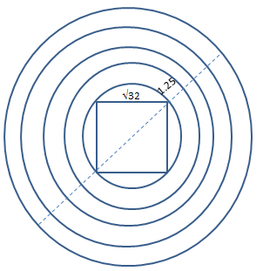

24. There are 5 concentric circles that are spaced equally from each other by 1.25 cms. The innermost circle has a square of side √(32) cm inscribed in it. If a square needs to be inscribed in the outermost circle, what will be its area?
A. 324 sq. cm. B. (66 + 40√2) sq. cm. C. 210.125 sq. cm. D. 162 sq. cm.
Solution:
From the figure, we can see that the diagonal of the square inscribed in innermost circle is the diameter of the innermost circle. Side = √32 Or Diagonal = √32 * √2 = 8 cm
Since the circles are spaced at 1.25 cm, the distance between innermost and outermost circles = 1.25 * 4 = 5 cm
Therefore the diameter of the outermost circle
=> 5 cm + diagonal of inscribed square + 5cm
=> 18 cm
Now this 18 cm will be the diagonal of the
square that needs to be inscribed in outermost
circle. Or a √2 = 18 a = 9 √2 cm Area = 9 √2 * 9 √2 = 162 sq. cm

Slide 31
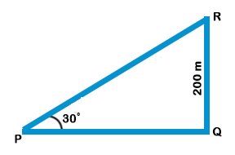
25. From a point P on a level ground, the angle of elevation of the top tower is 30º. If the tower is 200 m high, the distance of point P from the foot of the tower is:
A. 346 m B. 400 m C. 312 m D. 298 m
Solution:
tan30°=RQ/PQ 1√3=200/PQ
PQ=200√3=200×1.73=346 m

Slide 32
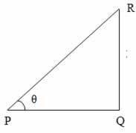
26. The angle of elevation of the sun, when the length of the shadow of a tree is equal to the height of the tree, is:
A. 45° B. 30° C. 90 ° D. 60°
Solution:
Consider the diagram shown above where QR represents the tree and PQ represents its shadow We have, QR = PQ Let QPR = θ tanθ=QR/PQ=1 (since QR = PQ) => θ = 45° i.e., required angle of elevation = 45°

Slide 33
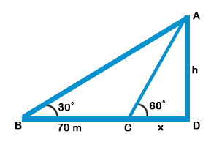

27. When the sun's altitude changes from 30° to 60°, the length of the shadow of a tower decreased by 70m. What is the height of the tower?
A. 35 m B. 140 m C. 60.6 m D. 20.2 m
Solution:
Let AD be the tower, BD be the initial shadow and CD be the final shadow. Given that BC = 70 m, ABD = 30°, ACD = 60°, Let CD = x, AD = h From the right triangle CDA, tan60°=AD/CD √3=h/x⋯(eq:1)
From the right triangle BDA, tan30°=AD/BD 1/√3=h/70+x ⋯(eq:2) eq:1/eq:2⇒√3/(1/√3)=(h/x)/(h/70+x) ⇒3=70+x/x ⇒2x=70 ⇒x=35 Substituting this value of x in eq:1, we have √3=h/35⇒h=35√3=35×1.73=60.55≈60.6

Slide 34

28. Solve cos θ + sin θ = √2, then the value of θ is:
Solution:
cos(θ)+ sin(θ) = √2 cos(θ)/ √2 + sin(θ)/ √2 = 1 (∵ divided throughout by √2) => cos(θ) cos(45) + sin(θ) sin(45)= 1
cos( θ-45) = 1 = cos0 ∴ (θ – 45 ) = 0 => θ = 45 = π/4

Slide 35
29. The value of is (tan47 + tan43) / (1-tan47tan43) is
Solution:
As, (tan A + tan B) / (1-tan A tan B) = tan(A + B)
=(tan47+ tan43) / (1-tan47tan43)
= tan(47° + 43°)
= tan90° = ∝

Slide 36
30. What is the value of cos 1º cos 2º cos 3º ….cos 90º?
Solution:
cos 90º = 0
∴ cos 1º cos 2º cos 3º ….cos 90º = 0

